Slide 1

CPQ – Asia Design and Mock Up Sept ‘19
Colt confidential

Slide 2

Document Release and Change Log Details
CPQ Asia
Version Number | 0.1
Date | 26th Nov, 2019
Change log | Connectivity Check

Slide 3
CPQ Asia: Connectivity Check : Asia
Japan , Singapore and Hong Kong supports ULL Fibre
ULL Fibre availability is provided by our preferred carrier to the Colt
CPQ will provide an option to check the ULL Fibre connectivity for these countries

Slide 4
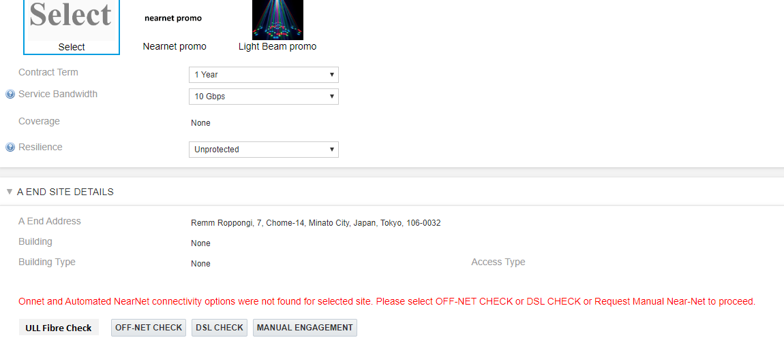
CPQ Asia: Connectivity Check : Japan
On the Site Detail page, there will be another option called ‘ULL Fibre Check’ which will be introduced.
ULL Fibre check will work only for Japan, Singapore and Hong Kong. For Other countries it would return a errorr message
This change is required across Ethernet Line, Ethernet Hub & Spoke, Wave & IPAccess

Slide 5
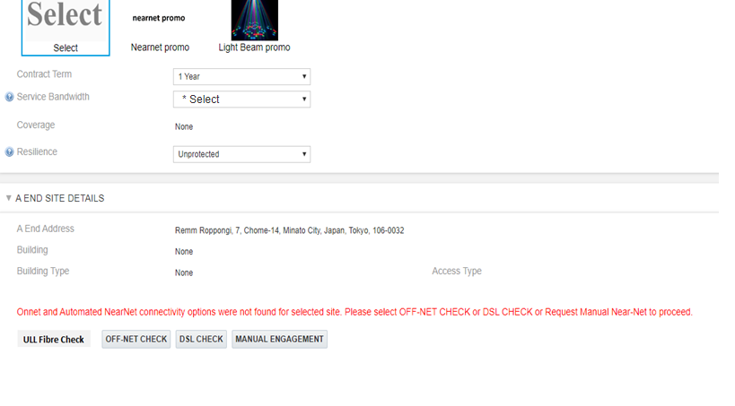
CPQ Asia: Connectivity Check : Japan
Only for Japan , when user clicks on the ‘ULL Fibre’ check button then system should check ‘Service Bandwidth’ and ‘Resiliency’ field are populated
In case they are missing , CPQ will be provide the necessary error message to select these fields
Please select bandwidth to proceed with the ULL Fibre check

Slide 6
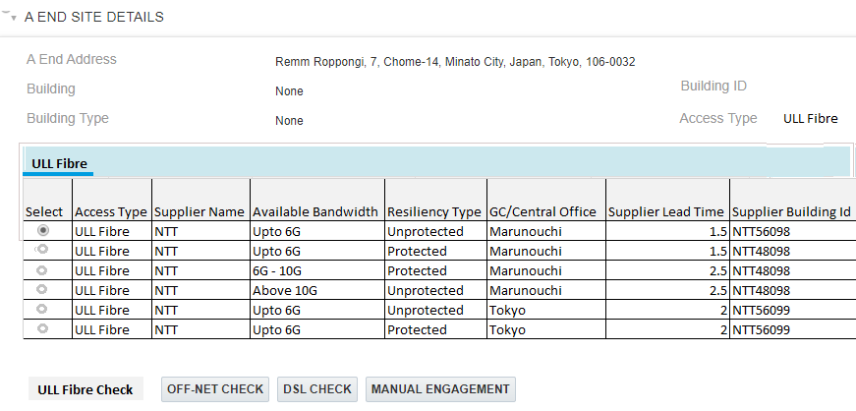
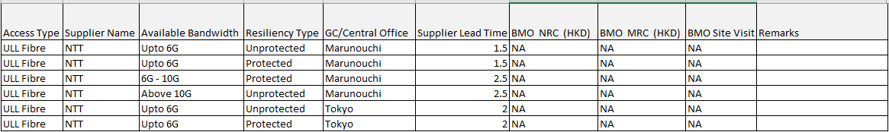
CPQ Asia: Connectivity Check : Japan
CPQ will present the ULL Fibre connectivity details in a tabular form in connectivity table.
CPQ will get the result back from the NTT data set
New Building
NTT5657
Retail Building

Slide 7
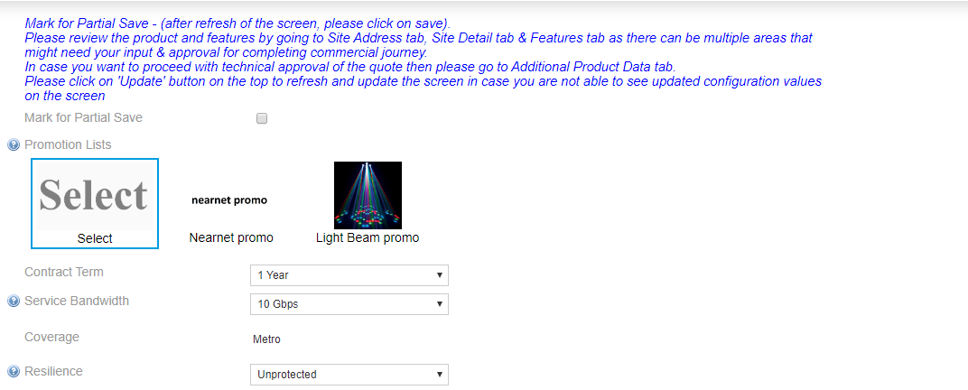
CPQ Asia: Connectivity Check : Japan
Once user selects an ULL Fibre option then the bandwidth and Resiliency will validated against what is present on the quote and appropriate error message will be shown
Bandwidth option selected in the ULL Table does match the Service bandwidth Please change the bandwidth or select another option from ULL table
Resiliency option selected in the ULL Table does match the Resiliency selected Please change the bandwidth or select another option from ULL table

Slide 8
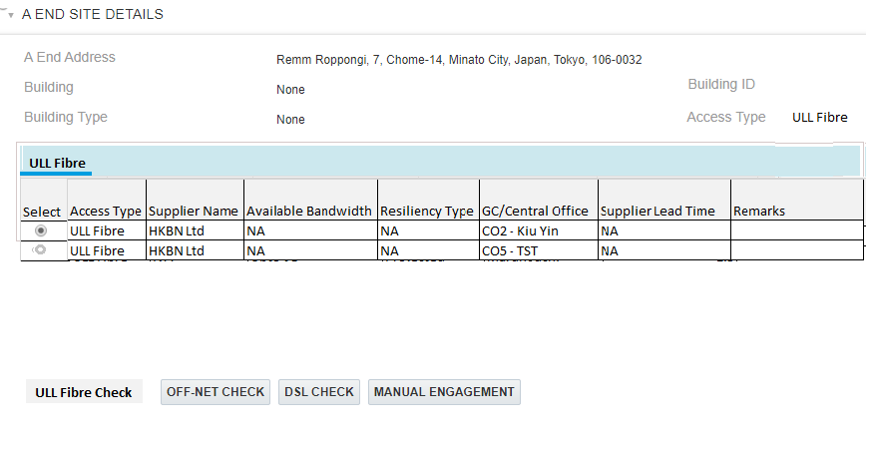
CPQ Asia: Connectivity Check : Hong Kong
CPQ will present the ULL Fibre connectivity details in a tabular form. CPQ will get the result back from the HKBN(Hong Kong) data set
For Hong Kong , system will display BMO charges in the connectivity table. These will not be applied automatically on the quote.
For Hong Kong, in case the building is more than 10 Km from central office. CPQ will automatically identify such building and apply the supplier surcharge
742-748 Cheung Sha Wan Road, Cheung Sha Wan, Hong Kong
New Building
HKBN1245
Retail Building

Slide 9
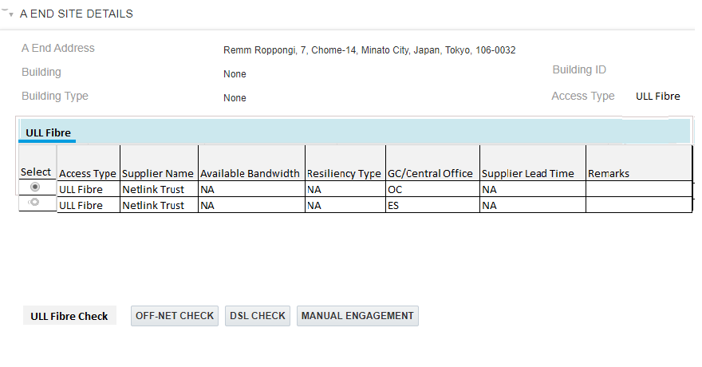
CPQ Asia: Connectivity Check : Singapore
CPQ will present the ULL Fibre connectivity details in a tabular form. CPQ will get the result back from the Netlink Trust data set
1, STRAITS BOULEVARD, CHINESE CULTURAL CENTRE, 018906, Singapore
New Building
NET76768
Retail Building

Slide 10
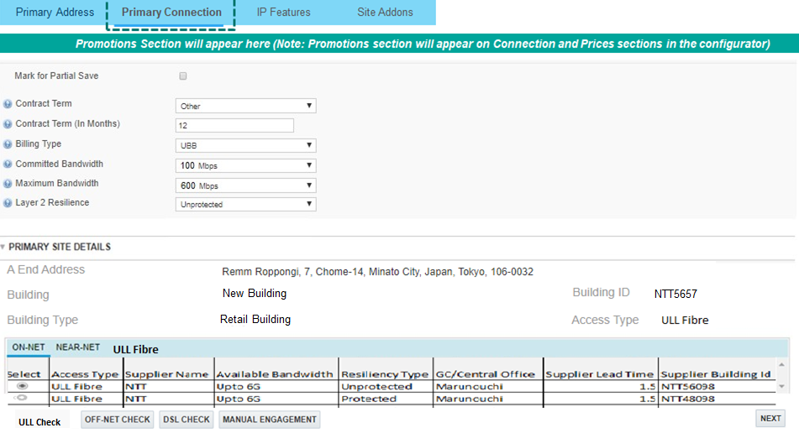
CPQ Asia: Connectivity Check : IPAccess : Japan
For IPAccess ULL fibre options will be available on Primary Connection page and Secondary connection page
Hong Kong and Singapore - ULL Fibre will work same as Ethernet line

Slide 11
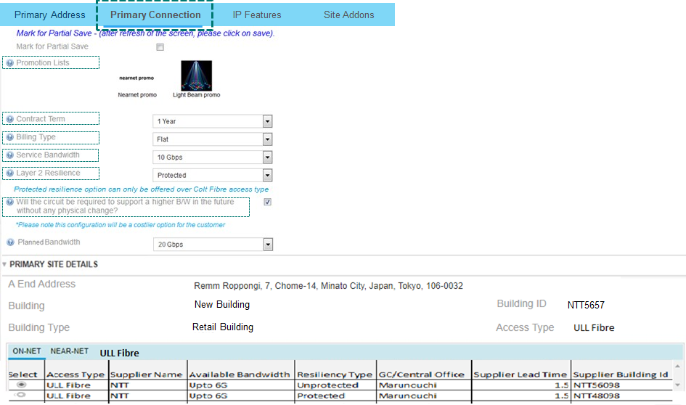
CPQ Asia: Connectivity Check : IPAccess : Japan
Once user selects an ULL Fibre option then the bandwidth and Resiliency will validated against what is present on the quote and appropriate error message will be shown
Scenario1: For IPAccess, if the billing type is Flat then the bandwidth check will be performed on Service Bandwidth
Bandwidth option selected in the ULL Table does match the bandwidth Please change the bandwidth or select another option from ULL table
Resiliency option selected in the ULL Table does match the Resiliency selected Please change the bandwidth or select another option from ULL table

Slide 12
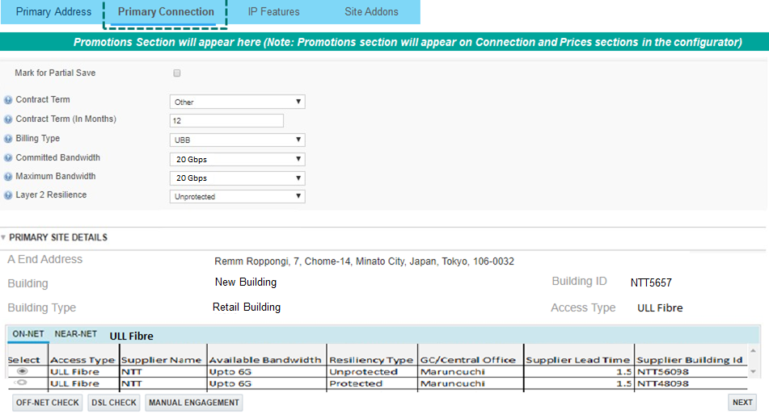
CPQ Asia: Connectivity Check : IPAccess : Japan
Once user selects an ULL Fibre option then the bandwidth and Resiliency will validated against what is present on the quote and appropriate error message will be shown
Scenario2: For IPAccess, if the billing type is UBB then the bandwidth check will be performed on Maximum Bandwidth
Bandwidth option selected in the ULL Table does match the bandwidth Please change the bandwidth or select another option from ULL table
Resiliency option selected in the ULL Table does match the Resiliency selected Please change the bandwidth or select another option from ULL table

Slide 13
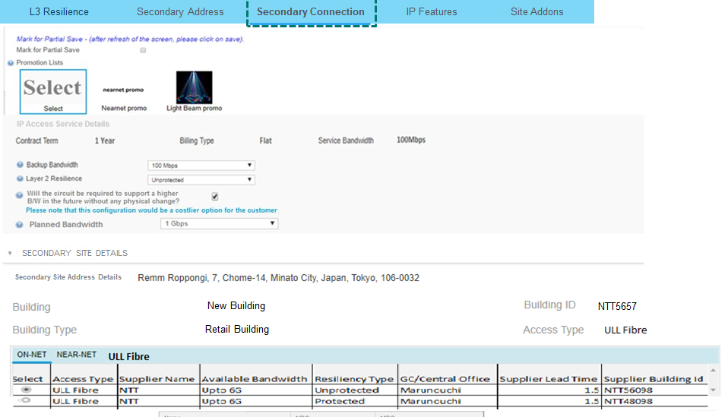
Once user selects an ULL Fibre option then the bandwidth and Resiliency will validated against what is present on the quote and appropriate error message will be shown
Scenario3: For IPAccess, for the secondary connection the bandwidth check has to be done against the Backup bandwidth
Bandwidth option selected in the ULL Table does match the bandwidth Please change the bandwidth or select another option from ULL table
Resiliency option selected in the ULL Table does match the Resiliency selected Please change the bandwidth or select another option from ULL table

Slide 14
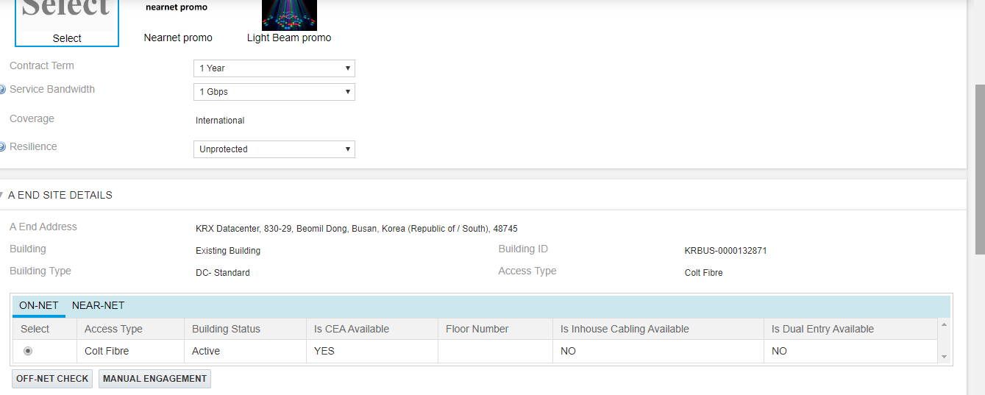

CPQ Asia: Connectivity Check : South Korea
For South Korea, we have a one DC building which provides on-net connectivity
Base price not found message comes in the pricing grid for this DC selection.
CPQ will not provide any additional logic to handle any product specific variation for this DC

Slide 15
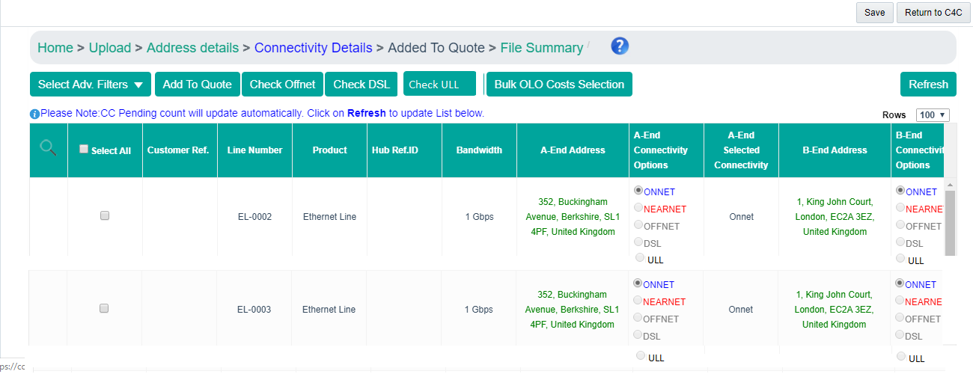
CPQ Asia: Connectivity Check: Bulk
ULL Check button should be introduced to execute the ULL check
No hiding rule is required for this button
For each line item a new radio button for ULL should be provided.
Remm Roppongi, Chome – 7, Minato City, Tokyo 106-0032
Villa Fontanne, Chome – 7, Minato City, Tokyo 106-0032

Slide 16
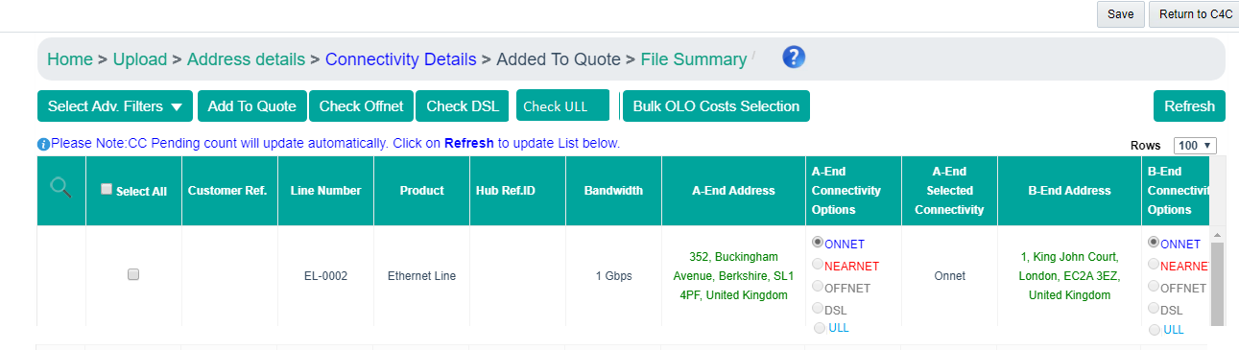
CPQ Asia: Connectivity Check: Bulk
In case the ULL check provides results back then the colour of the text (ULL) should change to blue. This indicates the availability
Remm Roppongi, Chome – 7, Minato City, Tokyo 106-0032
Villa Fontanne, Chome – 7, Minato City, Tokyo 106-0032

Slide 17
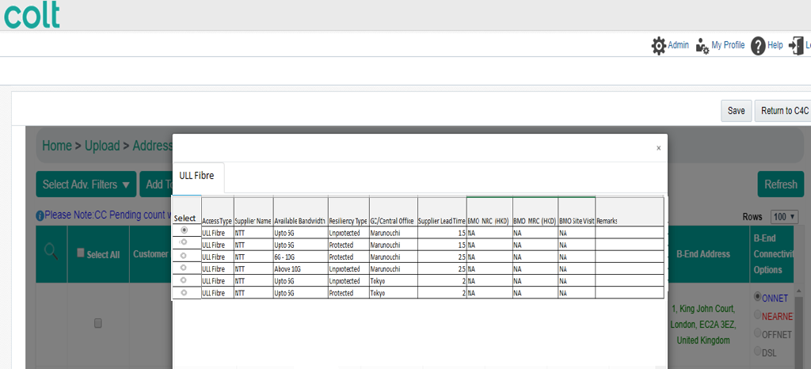
CPQ Asia: Connectivity Check: Bulk
Once user select the ULL Fibre posting running the ULL Fibre check then the records will be displayed to him in pop up (similar to Offnet)

Slide 18
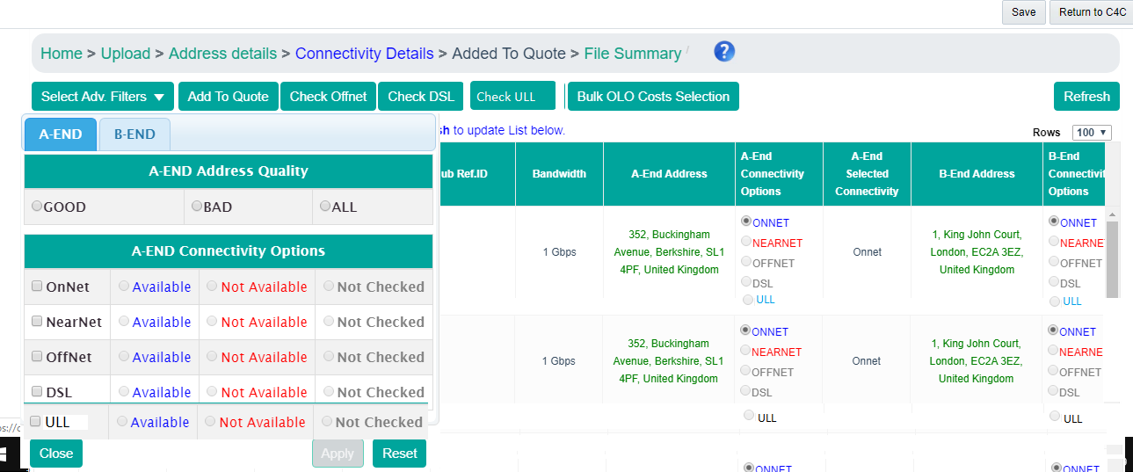
CPQ Asia: Connectivity Check: Bulk
Advance filter section to be updated to have the ULL option to filter out the records

Slide 19
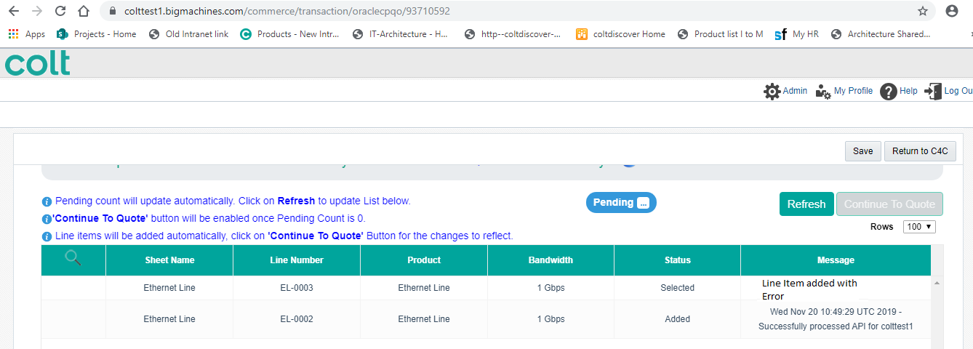
CPQ Asia: Connectivity Check: Bulk
In case the bandwidth and resiliency of the bulk record is not inline with the ULL fibre record selected on the connectivity page then system will show error to the user
User can correct the bandwidth on the CPQ config screen

